Slide 1


SAP S/4HANA CDS, BTP Full Stack Training Day 1
Anubhav Oberoy

Slide 2


Introduction

Slide 3




Who is this course for?
Maria
Raphel
Rohan
Sofia
SAP ABAP Consultant
SAP Solution Architect
SAP Technical Consultant
Project Manager
Notes:
https://unsplash.com/photos/0Zx1bDv5BNY
https://unsplash.com/photos/315vPGsAFUk
https://unsplash.com/photos/DItYlc26zVI
https://unsplash.com/photos/FttBXHp7VZw
https://unsplash.com/photos/et_78QkMMQs

Slide 4

Agenda – Day 1
What is SAP HANA
Hardware and Software Innovations
Row v/s Column Store
SAP HANA System Architecture
SAP HANA programming paradigm
Setting up Eclipse and ABAP Dev Tool (ADT)
--Break
Introduction to CDS Views
Common Myths about CDS Views
Create your first CDS View
Consume CDS view in ABAP Program
Notes:
https://unsplash.com/photos/CPs2X8JYmS8

Slide 5
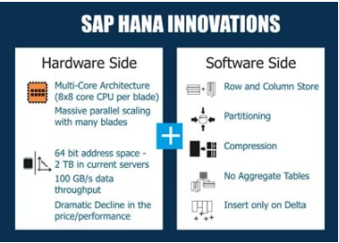
What is SAP HANA?
SAP HANA (high-performance analytic appliance) is an application that uses in-memory database technology that allows the processing of massive amounts of real-time data in a short time. The in-memory computing engine allows HANA to process data stored in RAM as opposed to reading it from a disk.
INNOVATIONS IN HANA
Several SAP HANA developers have made significant innovations in IT and in business models. Because of its in-memory approach, SAP HANA enables both hardware and software innovations which are unparalleled, replacing traditional databases in many spheres of business world! On the hardware side, SAP HANA facilitates Multi-Core Architecture (8×8 core CPU per blade), huge parallel scaling with several blades, 64 bit address space – 2 TB in current servers, data throughput as high as 100 GB/s, cost effectiveness and so on. On the software side, SAP HANA enables columnar data storage, partitioning, compression, eliminating aggregate tables, to name a few
01
Software Innovation
02
Hardware Innovation

Slide 6
Hardware & Software Innovation
Hardware innovations
Drastic reduction in memory price
Ability to fabricate large memory in small chips
Multi-core CPU
Interruptible power supply
64-bit OS
Specialized hardware which even process data in upper cache of CPU
HANA installation only works on specialized hardware certified by SAP – HP, Lenovo, Dell
Software Innovations
Able to compress data and store
Row store v/s Column Store
Able to use the OS level virtualization
Process data parallel
Insert-only approach
No Aggregation

Slide 7
Row Store v.s Column store
1001 | SHIP1 | MAT1 | 500 | USD | 1002 | SHIP1 | MAT2 | 600 | USD
1003 | SHIP2 | MAT1 | 300 | USD | 1004 | SHIP2 | MAT2 | 800 | USD
Total Sales in my sales table?
Row Store – it scans all the cells of the table
Column Store – it only need that single column cells
Get me all data (SELECT * FROM table)
Row Store – all the rows are stored together
Column store – it has to reconstruct the rows
If you use HANA DB to improve performance – avoid
Select *
ZMYSALES – Report – where you cannot avoid SELECT *
We create indexes in row store to improve read performance. Rowno, Column. In a column store DB we don’t need indexes hence less memory is consumed.
1,2 SHIP1
3,4 SHIP2
1001
1002
1003
1004
MAT1
MAT2
MAT1
MAT2
500
600
300
800
USD
USD
USD
USD
1 SHIP1
2 SHIP1
3 SHIP2
4 SHIP2

Slide 8
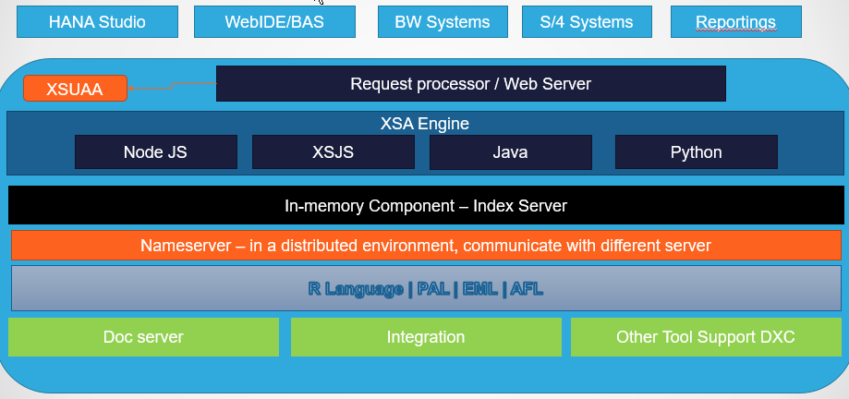
SAP HANA Architecture
SAP HANA System Architecture Overview. An SAP HANA system comprises multiple isolated databases and may consist of one host or a cluster of several hosts. An SAP HANA system is identified by a single system ID (SID) and contains one or more tenant databases and one system database.
Trainer: Anubhav Oberoy & Shubham Singh

Slide 9












































































Slide 10
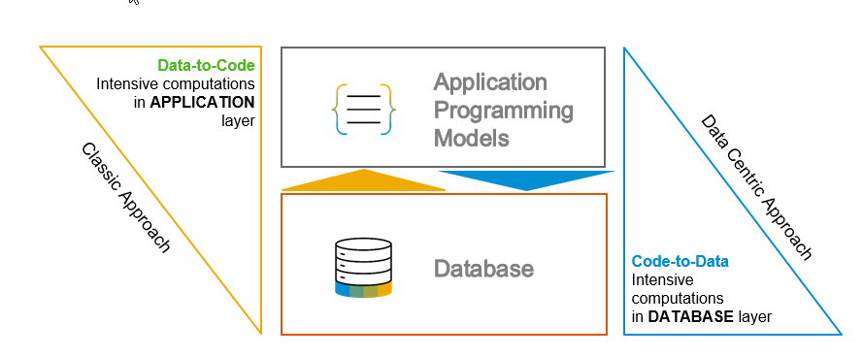
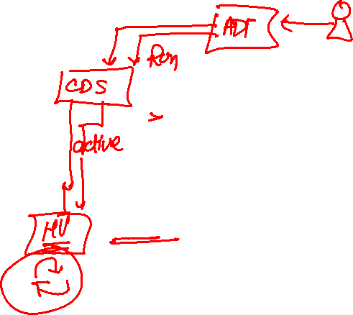
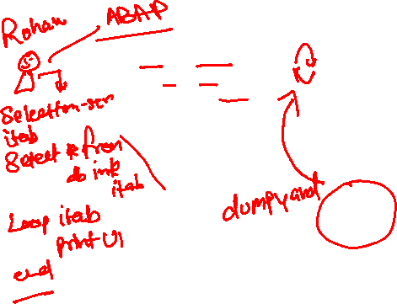
S/4 HANA, Suite on HANA and ABAP on HANA
Suite on HANA – Replace existing Any DB with HANA – SAP Product
S/4HANA – is also a product which is successor of Suite on HANA, Only runs on HANA – 2029 (all companies will be S/4)
ABAP on HANA – Technology on which these products are designed
Code push down
Code-to-data-paradigm
Most of the processing is pushed down to DB

Slide 11

Development Tools
SAPGUI
ABAP Development Tools
Application
SAP Netweaver
ADT
program
Eclipse
(open source)
Database - HANA
HANA Studio
www.anubhavtrainings.com

Slide 12
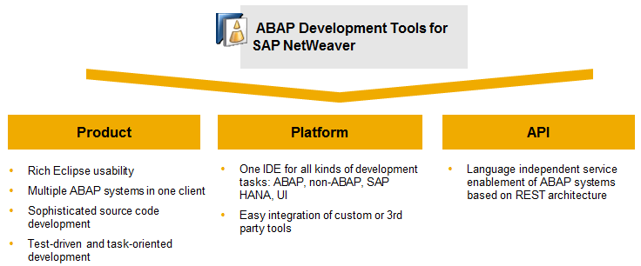
ADT Installation and System Access
ABAP Development Tools for SAP NetWeaver (ADT) enables ABAP developers to perform development tasks using the ABAP application server capabilities in an Eclipse-based IDE or on the classic ABAP Workbench.

Slide 13
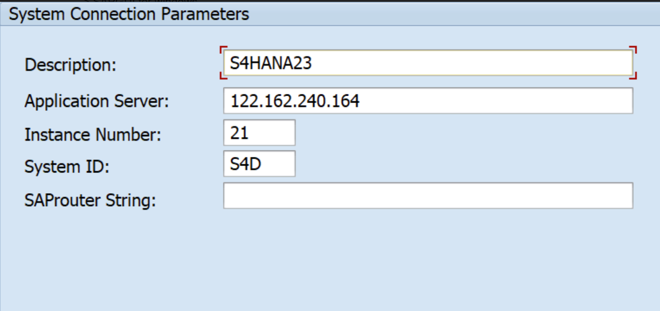
Setup of Eclipse and ADT
Official documentation - https://tools.hana.ondemand.com/#abap
Pre-Requisites:
You must have to have Java 1.8 and above
You must have SAP GUI already installed in your system
Also for windows laptop needs the For Windows: Microsoft Visual C++ 2013 Redistributable (x64) (Note: Precisely version Visual Studio 2013 (VC++ 12.0) x64 is required).
Procedure
To install the front-end component of ADT, proceed as follows:
Get an installation of Eclipse 2023-06 (x86_64) (e.g. Eclipse IDE for Java Developers)
In Eclipse, choose in the menu bar Help > Install New Software...
Enter the URL https://tools.hana.ondemand.com/latest
Press Enter to display the available features.
Select ABAP Development Tools and choose Next.
On the next wizard page, you get an overview of the features to be installed. Choose Next.
Confirm the license agreements and choose Finish to start the installation.
www.anubhavtrainings.com

Slide 14
Benefits of ADT
Eclipse is a free tool and open source used by billions of developers in industry
You can work simultaneously with Dev, Qlt, and production
It is also seamlessly integrated with SAP GUI, you can use Ctrl+6 to open a GUI window.
Different systems, different landscapes, different types comes together in a single development environment, it will help to avoid context switching as a result we have better developer experience
Flexible and customizable development environment (Ctrl+M)
Fast search and navigation capabilities using Ctrl+Shift+A
For ABAP on HANA development this is the Only tool you must have to use –CDS Views, AMDP etc.
Support for Transport, Debugging, Profiling and ATC check features
Eclipse is multi purpose tool – ABAP, Java, Java Script, Web, C, EJB, UI5
It supports all SAP developments – Scripts, Dialog, Webdynpro, DDIC, Classes, RICEF
Inbuilt Quick fix feature
Modularize your code easily
Code templates
www.anubhavtrainings.com

Slide 15

Setting up VS Code Development tool
Development tool – VS Code (free, offline, billions of dev) + Extensions (Java Extension pack, Spring Extension pack, Fiori Extension pack and SAP CDS language support)
https://code.visualstudio.com/download

Slide 16
What is CDS and Some common Myths
CDS stands for Core Data and Services, They are used ABAP on HANA systems (mainly S/4HANA) to define data definitions and semantically rich data (annotations) models. They supplements the SQL code in ABAP. It is an extension of SQL in ABAP layer.
What has been extended?
DDL (Data Definition Language) – people don’t use this much because we have SE11 and its one time job
DQL (Data Query Language) – View concept – 95%
DEL (Data Expression Language)
DCL (Data Control Language)
Can I create CDS views in my company system even we are not on HANA?
Yes, Your SAP NetWeaver must be above NW 7.4 SP6
Is CDS concept only used to create views, or there can be another use case of CDS?
We can define types using CDS.
Which layer do we create CDS view.
Create them in ABAP layer, on activation a HANA view (runtime object) gets created in HDB
Which tool do we use to create CDS views, is SAPGUI used?
ADT, GUI CANNOT be used.
www.anubhavtrainings.com

Slide 17
Some common Myths….
Which is the minimum SAP NW version required to create CDS views, is it mandatory to use HDB?
SAP NW 7.4SP6, HANA is not mandatory but for BEST performance you should use HANA
I heard about HANA CDS, how HANA CDS different from ABAP CDS?
In this course, we only learn ABAP CDS. HANA CDS is used in Native HANA Dev.
https://www.youtube.com/watch?v=rTsAg_OGh-A
If you got to choose between CDS and AMDP?
CDS is first preference. CDS works on database agnostic, client handling, complexity.
We already have 4 types of views in ABAP, Why should I learn CDS view now?
Park
What is the actual Code to data paradigm object which is created in HANADB?
A HANA view gets created in HDB which is the actual runtime object called when you run CDS.
www.anubhavtrainings.com

Slide 18
Some common Myths…
I am from BW background, have no idea on ABAP, can I learn CDS views?
Yes, You must learn because now a days companies moving from Bex to CDS views. No ABAP required.
Will CDS views only be created in S/4HANA systems?
No, Any ABAP on HANA systems above NW7.4 SP6
How CDS views different from Calculation view you taught earlier?
Calculation views are bottom-up approach cannot use this approach in S/4HANA. CDS views are top-down
What are the types of CDS views?
Parameterized CDS views and Non-parameterized CDS views
Is it also possible to insert/update data using CDS views?
No. If you combine CDS view concept with frameworks like BOPF or RAP
What is the best practice/gold standard to create CDS views?
VDM – Virtual data modelling – guidelines to build cds views in S/4HANA
www.anubhavtrainings.com

Slide 19
Some common Myths..
Are there standard CDS views delivered by SAP, can I see them?
Yes. https://api.sap.com
Is it possible to extend standard SAP delivered CDS views?
Yes
Anubhav, recently my friend told me that CDS views are deprecated, is it true?
Yes, there is a new concept called CDS entity, which identically.
I worked in a project where we use something called VDM?
It is a best practice to create CDS views.
www.anubhavtrainings.com

Slide 20
Some common Myths…
Can I integrate SQL Script also using CDS?
Yes, there is a advance concept called CDS table function starting NW 7.5
Can I also secure my data coming out of CDS view with some kind of Authorization/Role?
Yes
I tried hard to learn CDS from google, but rather learning I got more confused?
Park
What is metadata extension in CDS?
Park
www.anubhavtrainings.com

Slide 21










































Slide 22
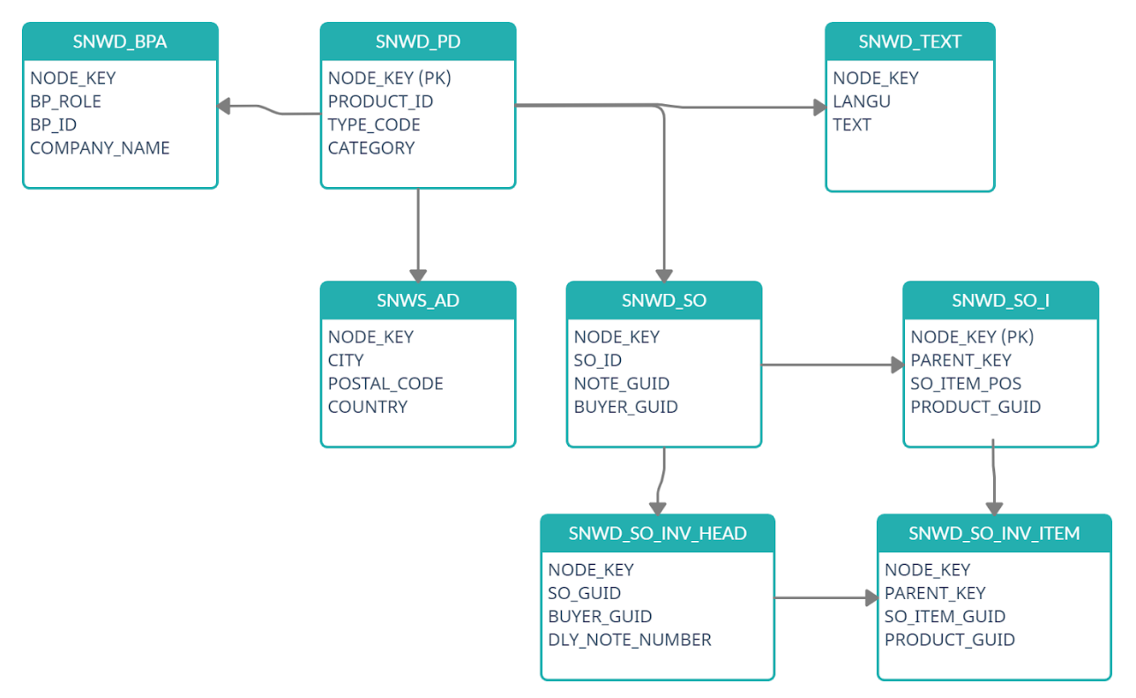
EPM Data Model

Slide 23
After Break
Understand data model
Create your first CDS View
Consume CDS view in ABAP Program
Working with CDS entity
--break
Understanding CDS entities examples
Difference SE11 and CDS views
CDS perspective
--break
VDM – Virtual Data Model
Arrangements for VDM objects
Analytic use case
CDS Security and Steps for securing data
Notes:
https://unsplash.com/photos/CPs2X8JYmS8

Slide 24
What happens when we activate
DDIC view SE11
CDS views
activate
HANA Views
www.anubhavtrainings.com

Slide 25

CDS Entities
CDS Entities are successor of CDS Views. CDS views are deprecated, use CDS entities. CDS views and entities are absolutely same, whatever knowledge you have or gained on CDS views, can be applied on entities.
When we create a entity, system do not create the DDIC view
It saves time hence the activation time of CDS has been improved 90%
With CDS entity there is no name confusion, its just one name for everything.
The generated HANA view name will be same as the name of the main view
CDS entities are stricter in nature
Limitations
For analytical use cases, we still rely on cds views
For bopf integration still we use cds views
For advance concepts like RAP, we can do on entities only.
9
www.anubhavtrainings.com

Slide 26
Working with CDS Examples
Working with CDS entity and CDS with Expression Language (DEL)
View on View Concept
In a real time, environment, we do not want to clutter all our code inside single CDS view. Because we want to achieve modularization. In View-on-View concept, we will consume one view on top of another view. This way we can create multiple reusable views and consume them in upper views.
Adding Aggregation to CDS entities
Joins using CDS entities
Concept of Association
Associations are the relationships between entities and views. It is used to avoid joins, because joins are bad for performance, associations are loose coupling between our data. The data will fetched on-demand when it requested. The join will be performed only when needed, hence saves lots of time.
There are 2 types of association
Ad-hoc association – just exact join
Exposed association – lose coupling

Slide 27
Difference between SE11 Views and CDS views
Parameters | CDS Views | DDIC Views
Code To data paradigm | Yes | No
Complexity | Yes | No
Outer join is supported | Yes | No
Support unions | Yes | No
Complex Expression language | Yes | No
Ability to aggregate data and write where on aggregated | Yes | No
Analytical consumption | Yes | No
Support for OData Service | Yes | No
Allowing Type definition | Yes | No
Metadata extension for UI Consumption | Yes | No
Parameters and predicate support ($session) | Yes | No
S/4HANA Embedded Analytics Support | Yes | No

Slide 28
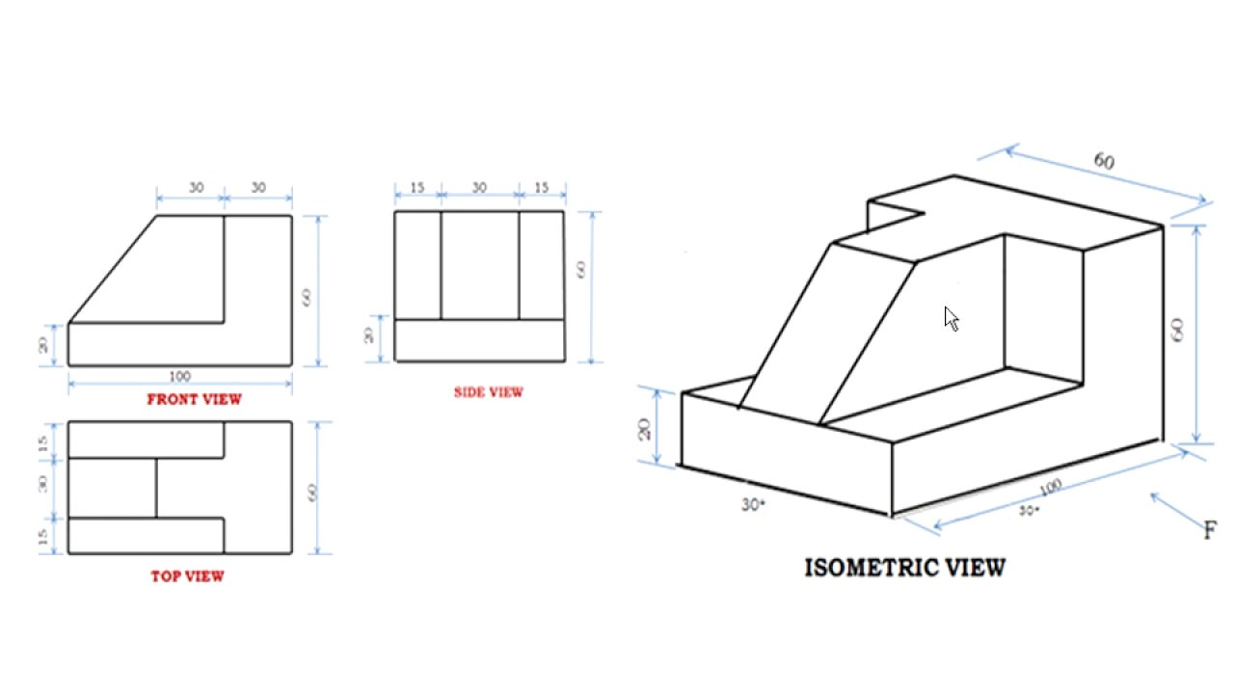
Why someone fails to learn CDS from google?
< >
9
www.anubhavtrainings.com

Slide 29

CDS Perspective
ABAP Program
@Odata.publish
Fiori App
@Analytics
@AnalyticDetails
CDS View
Data Analytics
@Odata.publish
S/4HANA embedded Analytics
@Analytics
@AnalyticDetails
Integration API
@Odata.publish
@ObjectModel
RAP/BOPF
9
www.anubhavtrainings.com

Slide 30
VDM – Virtual data modeling
Is a gold standard and best practice to build CDS views in S/4HANA projects. This standard is adopted already by SAP so by learning this you will also be able to understand standard CDS view structures.
When we join a project, we would not need any KT from anyone if project follow VDM
In absence of a colleague, we will be able to manage the development and understand purpose
When SAP deliver standard CDS views, they do not share mobile no. of their SAP labs developer
It allows great modularization and the best practices for a scalable project design
Interface views
Private
Consumption
Starts with P_
@VDM.private: true
These are the views built by SAP and reused by SAP itself.
As a developer we can use private views to build our views but we must not?
SAP do not guarantee the stable contract
Basic
Composite
Starts with C_, @VDM.viewType : #COMPOSITION
They are used for final consumption for our use case e.g. Fiori App, Analytics, Integration etc.
Annotations related to final UI and tool consumption
In Data analytics we create with annotation @Analytic.query: true
Which creates a BeX query in SAP S/4HANA.
Starts with I_, @VDM.viewType : #BASIC, #COMPOSITE
We can certainly use them in our projects, view on view because contract remains stable RoR
Basic views are always used to ready either Pure Master or Pure transaction
If we want combination of master and transaction data we can go with composite views
A composite view can act like a #CUBE view for data analytics. Usually these views are used to aggregate data with @DefaultAggregation annotation
We can build interface views on top of private(our) or other interface views
9
www.anubhavtrainings.com

Slide 31
Arrangement
Fiori App
Analytic Tools
Third Party
API Consumer
Consumption views
Consumption views
@Analytic.query
Interface composite views
Interface Composite views
#CUBE
Basic interface views
Basic interface views
Basic interface views
Private views
Private views
DB Tables
DB Tables
DB Tables
DB Tables
DB Tables
DB Tables
DB Tables
9
www.anubhavtrainings.com

Slide 32
Use Case
We are working as S/4HANA consultant in a company, the company have sales stored in the EPM data table. We would like to build a dashboard to help company projecting following requirement
Total sales per Country – total gross amount, max net amount, average tax amount
Total Sales per Currency
Total Sales per Product
Total Sales per Customer
9
www.anubhavtrainings.com

Slide 33

Questions?

Slide 34

Thank you
Anubhav.abap@gmail.com
contact@anubhavtrainings.com
+91 84484 54549
www.anubhavtrainings.com

